Slide 1

Sports E-Commerce Website
BCAD681

Slide 2



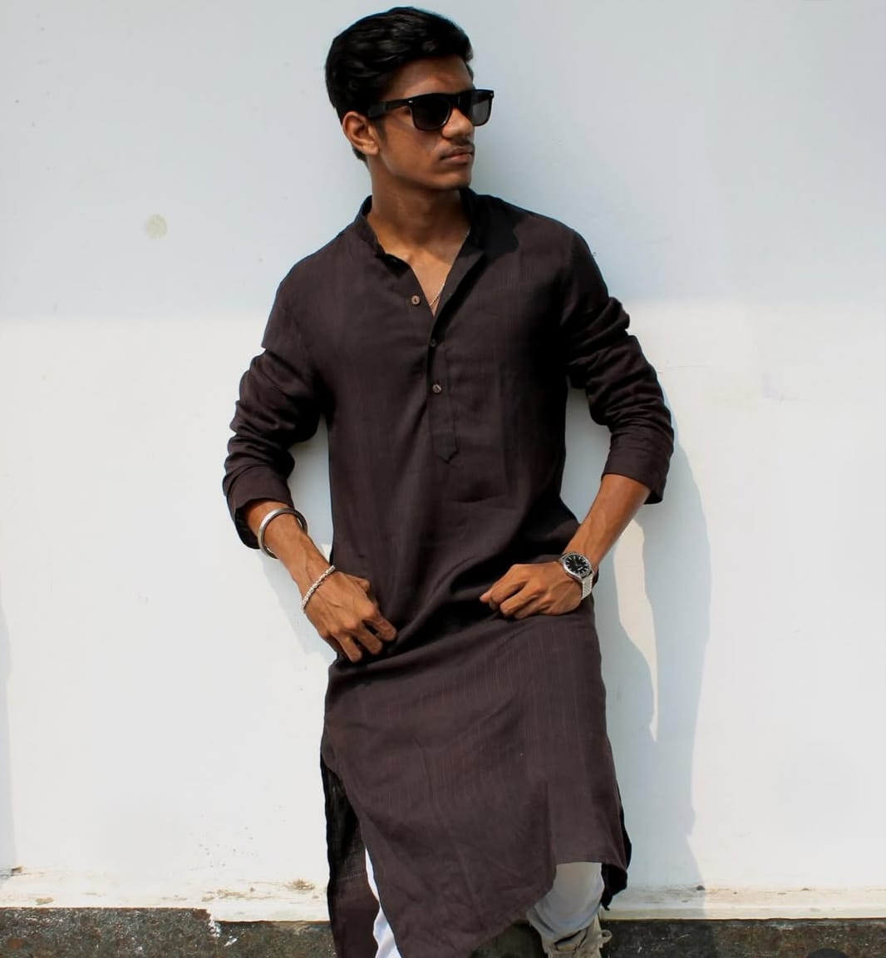

OUR TEAM
SUBHAM DUTTA
(30901222186)
PUSPAL BISWAS
(30901222187)
KOUSHIK MAJHI
(30901222033)
SHIVAM DAS
(30901222034)
ANUPAM MONDAL
(30901222043)

Slide 3


GOAL OF THE PROJECT
The goal of HotShop is to provide a one-stop online platform for customers to discover, compare, and purchase high-quality sports and fitness products across a wide range of categories, including apparel, equipment, accessories, and wellness essentials. The platform is designed to ensure affordability, accessibility, and a seamless, user-friendly shopping experience that caters to the needs of beginners, enthusiasts, and professional athletes alike. By offering reliable products, personalized recommendations, and secure delivery, HotShop aims to make sports gear easily available to people of all age groups and skill levels, thereby promoting a healthy, active lifestyle and encouraging long-term fitness habits across diverse communities.

Slide 4
BASIC REQUIREMENTS
SOFTWARE REQUIREMENTS
HARDWARE REQUIREMENTS
IDE: Spring Tool Suite 6, Visual Studio Code
BACKEND: MySql(Database), Java (Spring), JVM (JDK22).
FRONTEND: REACT, MUI, Tailwind CSS
OPERATING SYSTEM: Windows XP or Higher Version.
PROCESSOR: Intel i3 7th Generation or above.
RAM: 8GB
HARD DISK DRIVE: 500 GB

Slide 5
Cost Estimation(COCOMO MODEL)
ORGANIC METHOD:
A | B | C | D | Effort | Development Time | Average Staff Size | Productivity
2.4 | 1.05 | 2.5 | 0.38 | 9.803 | 5.951 | 1.647 | 0.389
SEMI-DETACHED METHOD:
A | B | C | D | Effort | Development Time | Average Staff Size | Productivity
3.0 | 1.12 | 2.5 | 0.35 | 13.459 | 6.210 | 2.167 | 0.283
EMBEDDED METHOD:
A | B | C | D | Effort | Development Time | Average Staff Size | Productivity
3.6 | 1.20 | 2.5 | 0.32 | 17.979 | 6.301 | 2.853 | 0.212
CALCULATION PARAMETERS:
1. Effort = a (KLOC)^{b} Person-Month
2. Development Time = c (Effort)^{d} Months
3. Average Staff Size = Effort/Development Time Persons
4. Productivity = KLOC/Effort KLOC/Person-Month LOC value for our project = 3820 (∴ KLOC value (estimated) = LOC/1000 = 3.820)

Slide 6
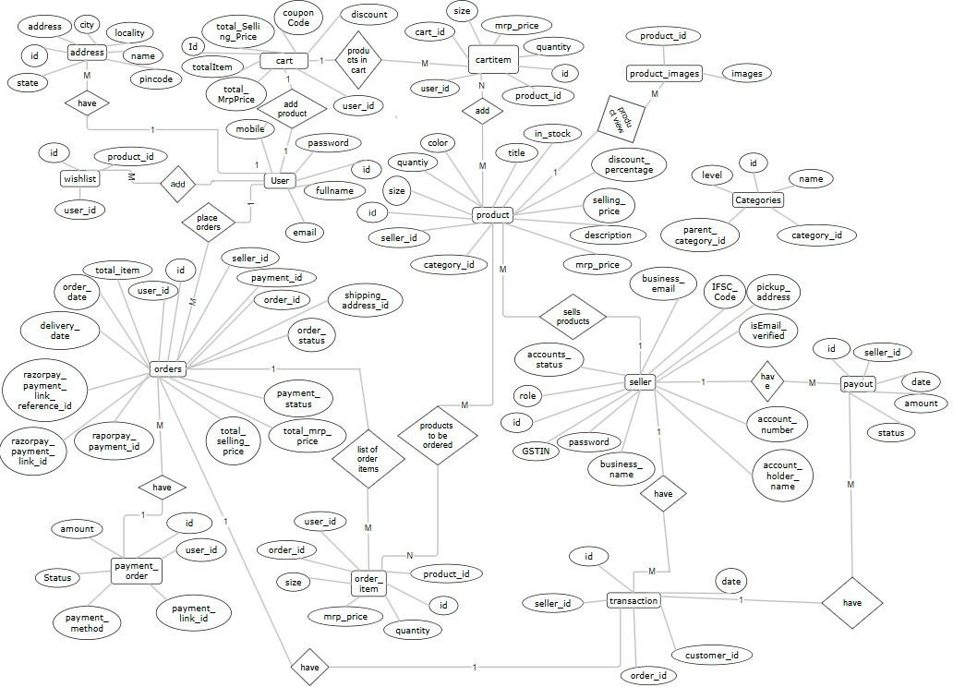
ENTITY-RELATIONSHIP DIAGRAM

Slide 7
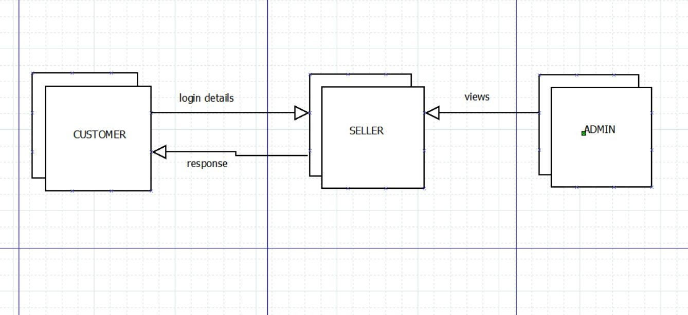
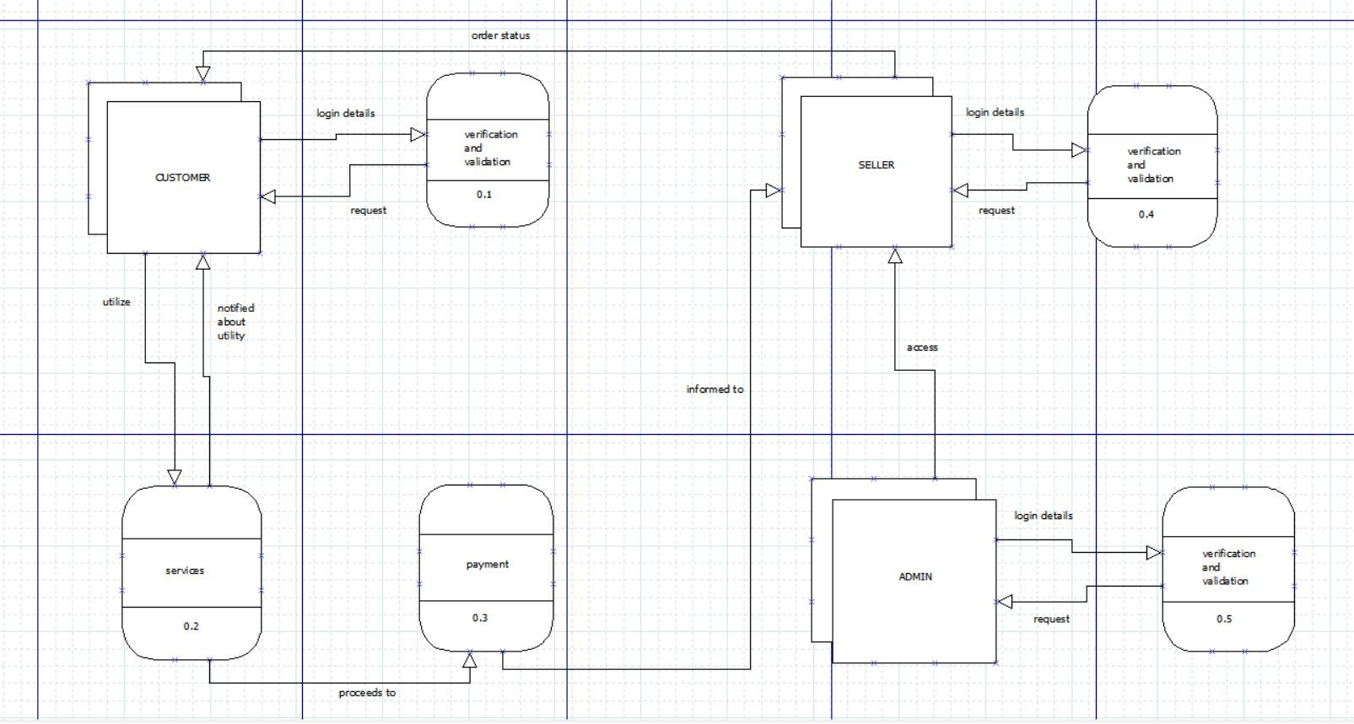
DATA FLOW DIAGRAM:
LEVEL - 0 DFD
LEVEL – 1 DFD

Slide 8
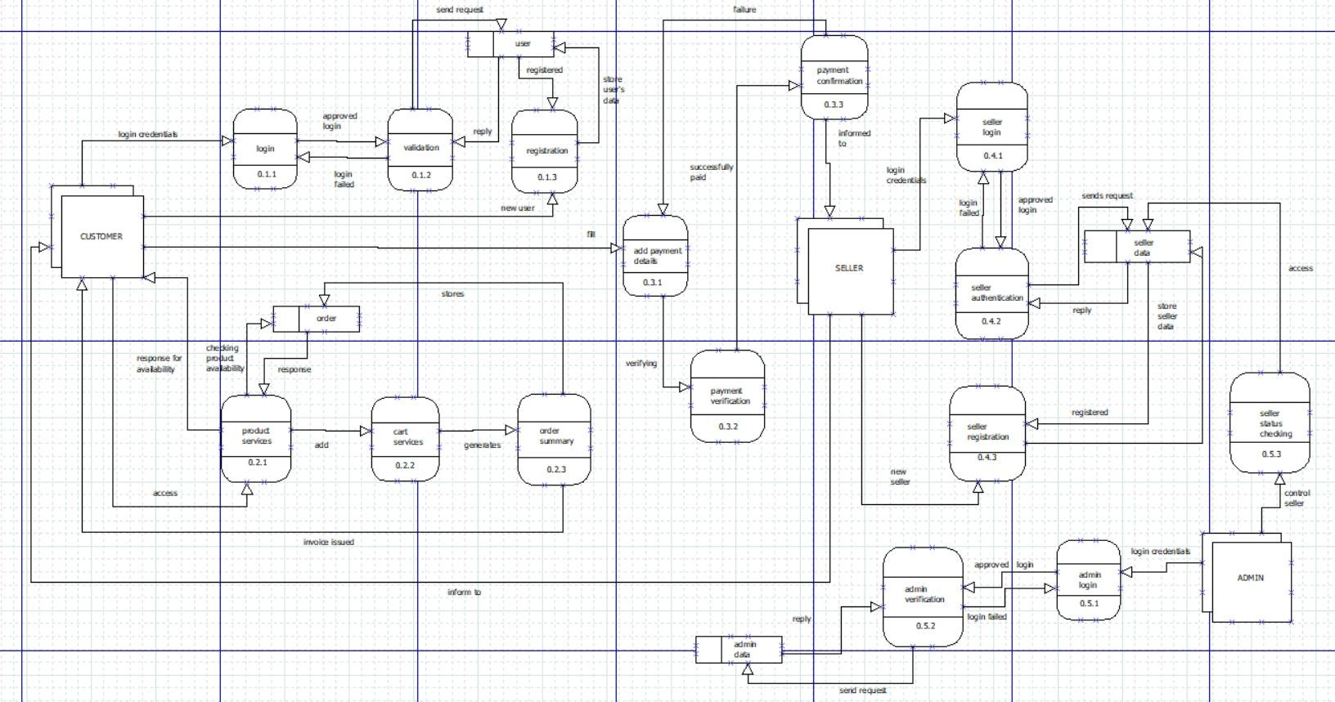
DATA FLOW DIAGRAM:
LEVEL – 2 DFD

Slide 9
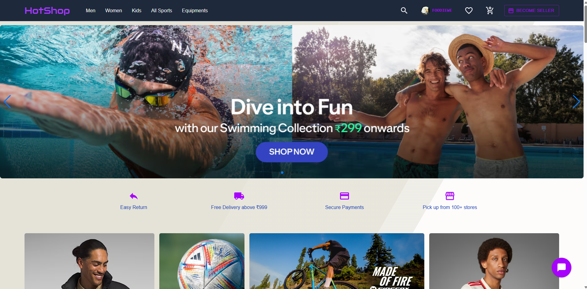
SCREENSHOTS
HOMEPAGE:

Slide 10
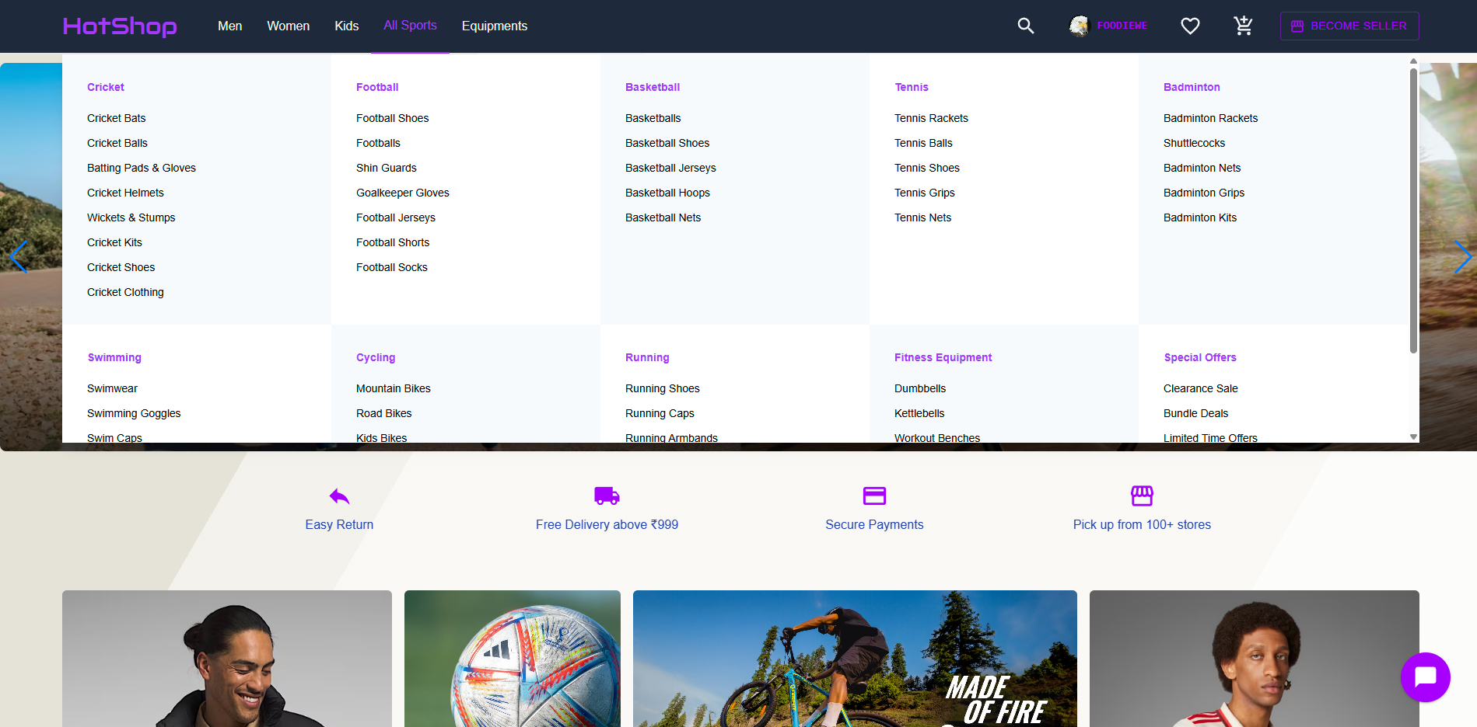
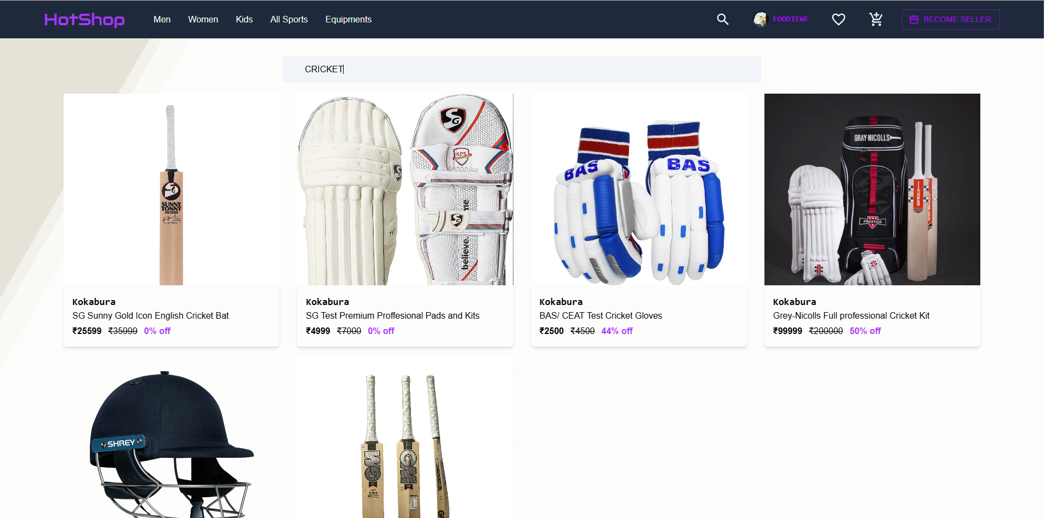
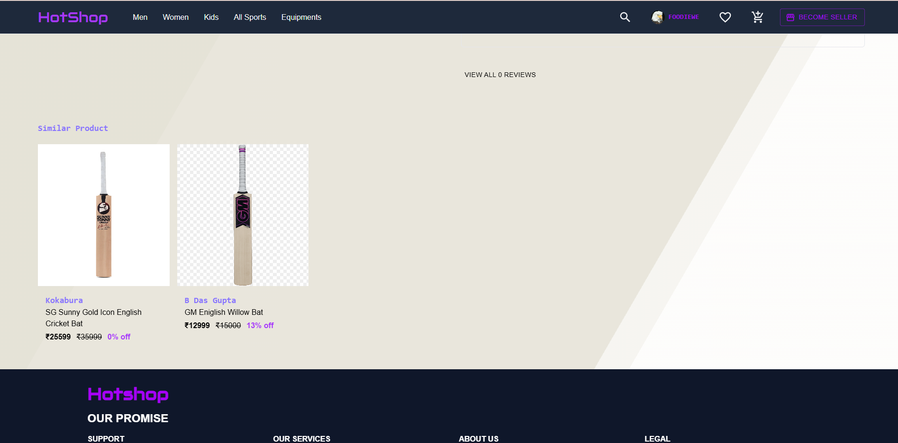
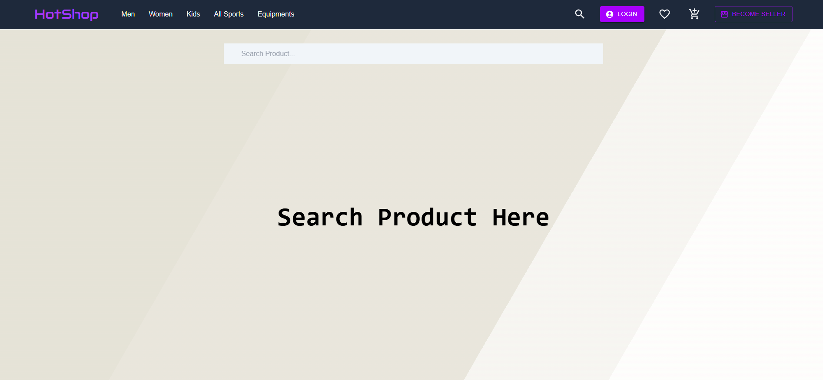
CUSTOMER GRID
PRODUCTS
SIMILAR PRODUCTS
SEARCHBAR

Slide 11
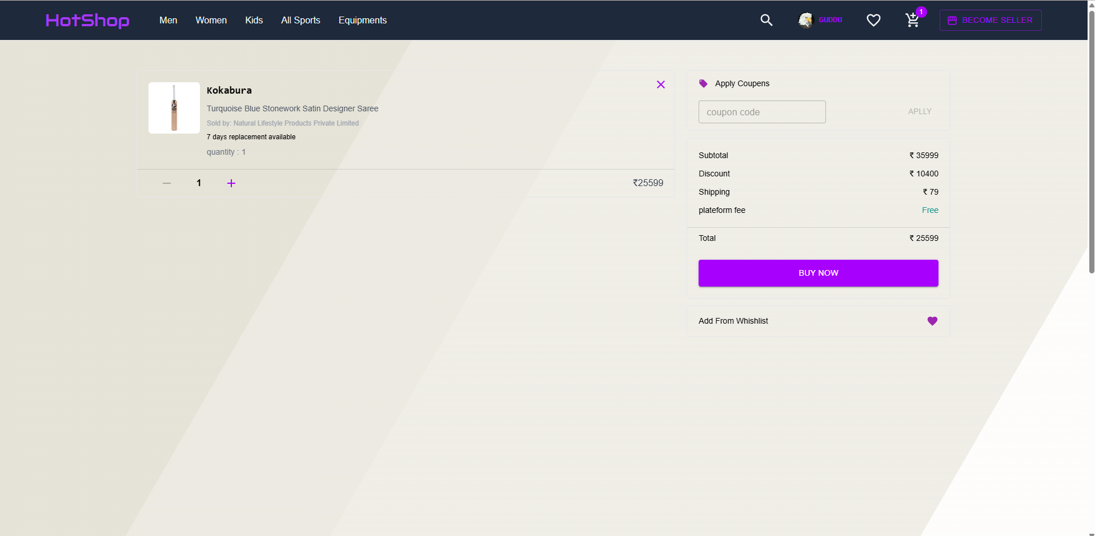
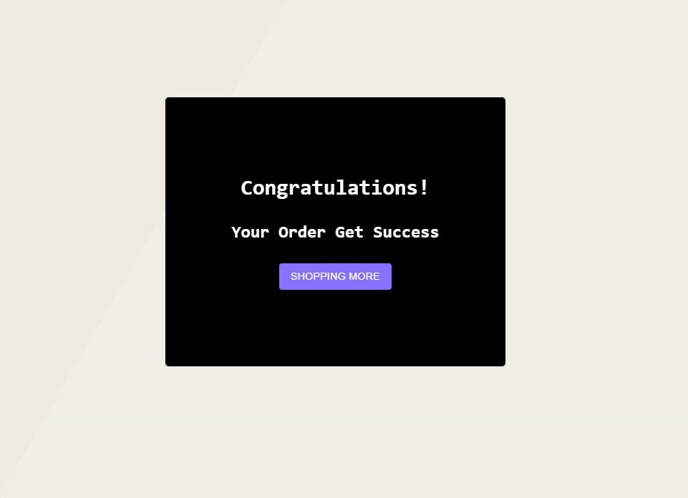
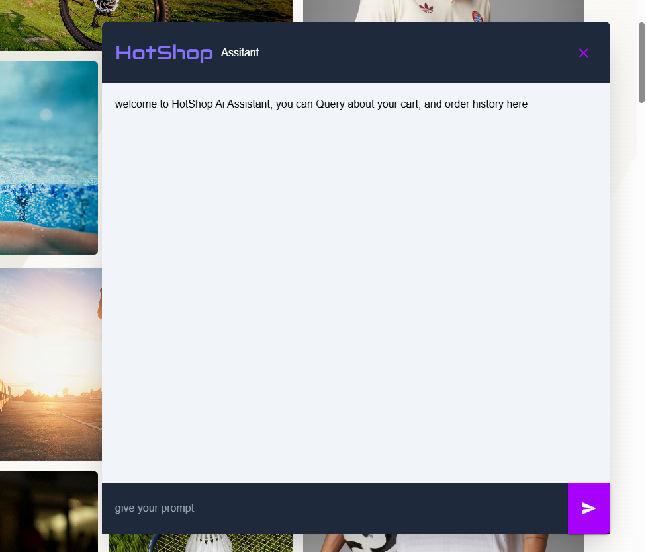
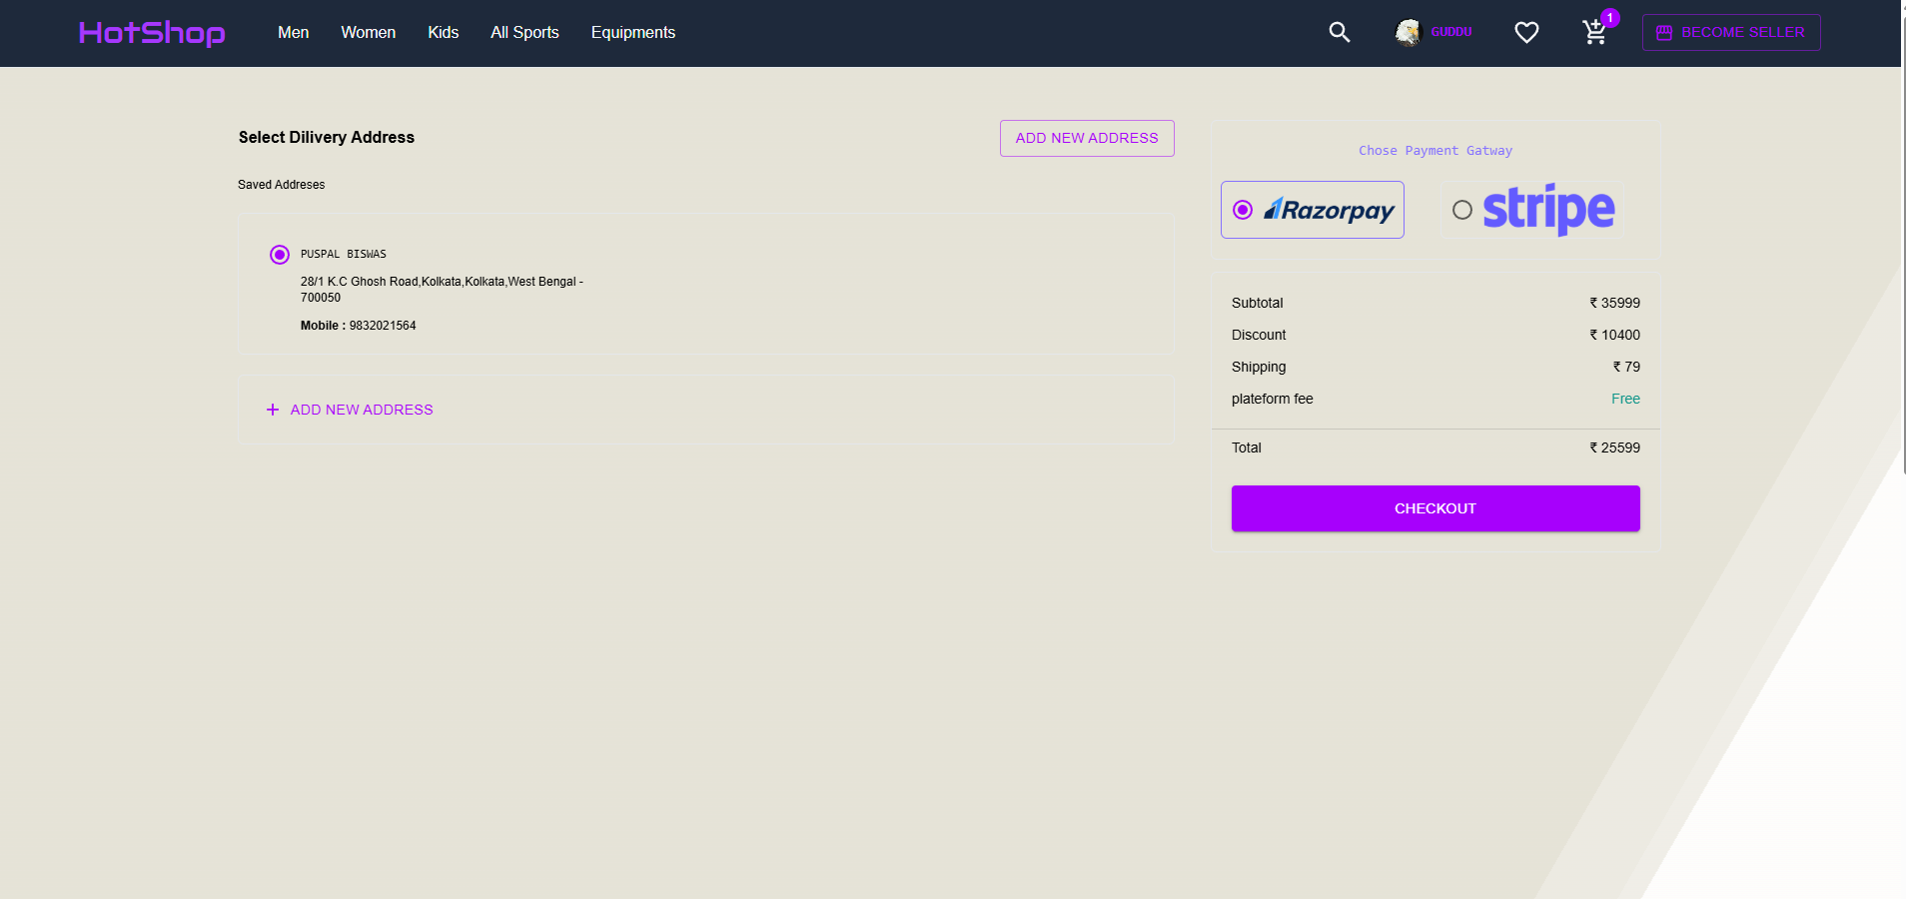

CART
ORDER CONFIRMANTION
CHATBOT AI
CHECKOUT
FOOTER

Slide 12
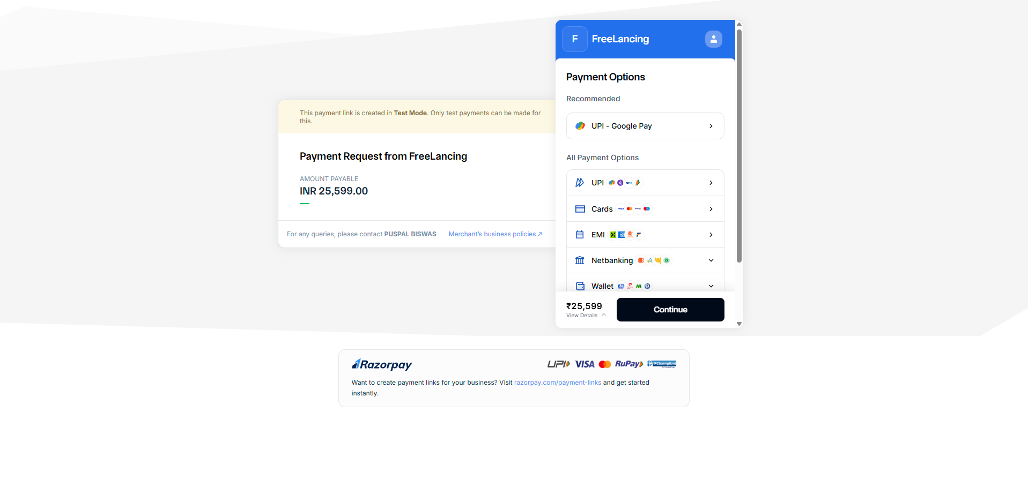

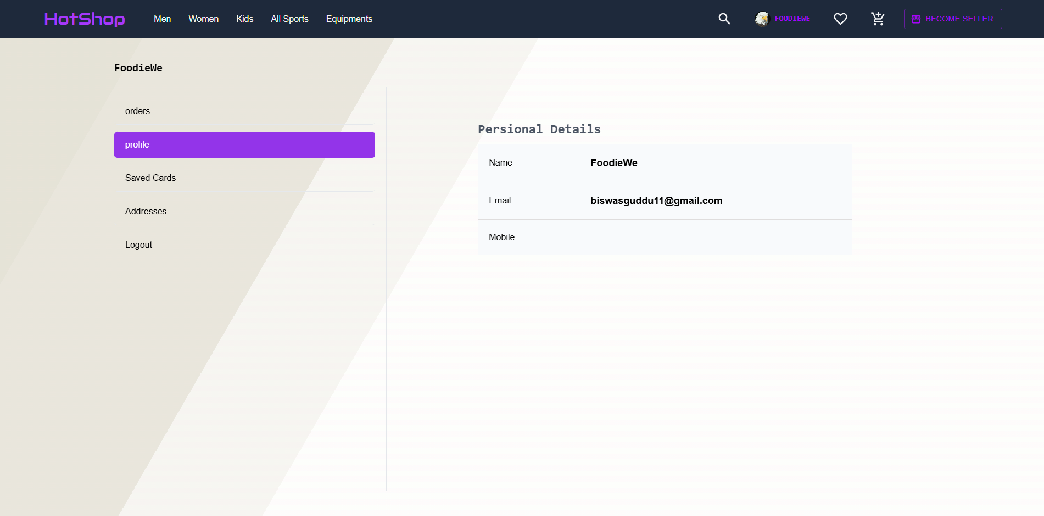
PAYMENT GATEAWAY
SIGNUP PAGE
PROFILE

Slide 13
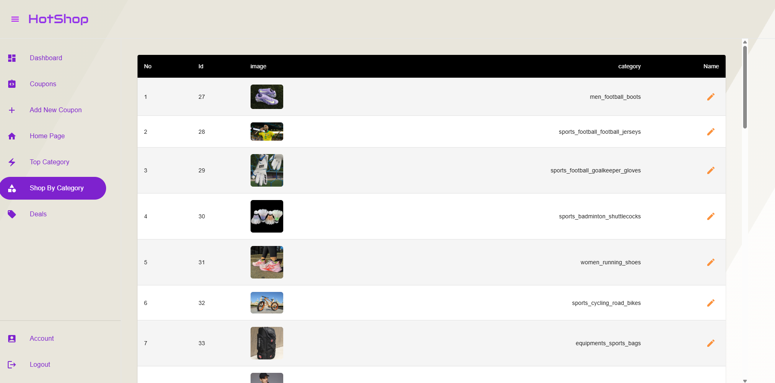
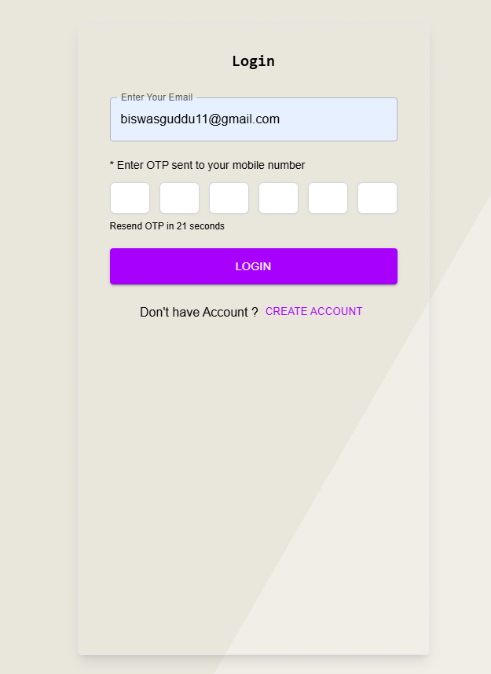
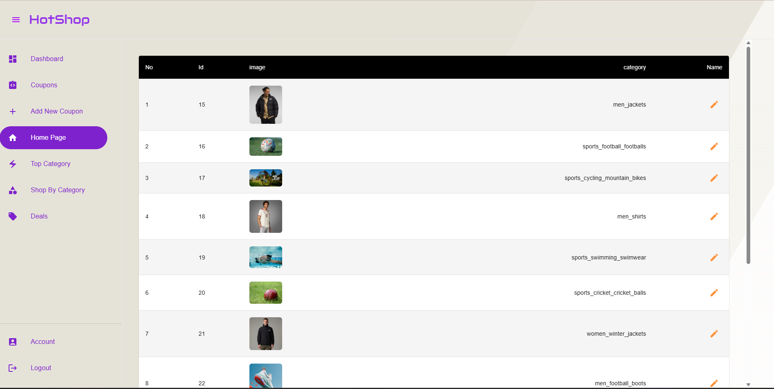
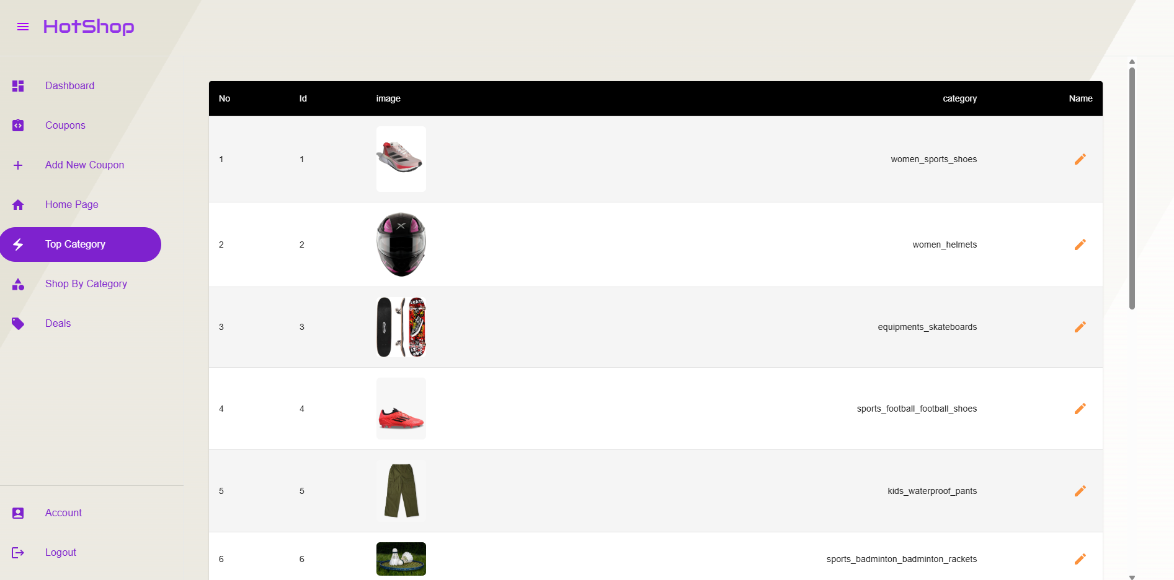
CATEGORY
ADMIN LOGIN
HOMEPAGE
TOP CATEGORY

Slide 14
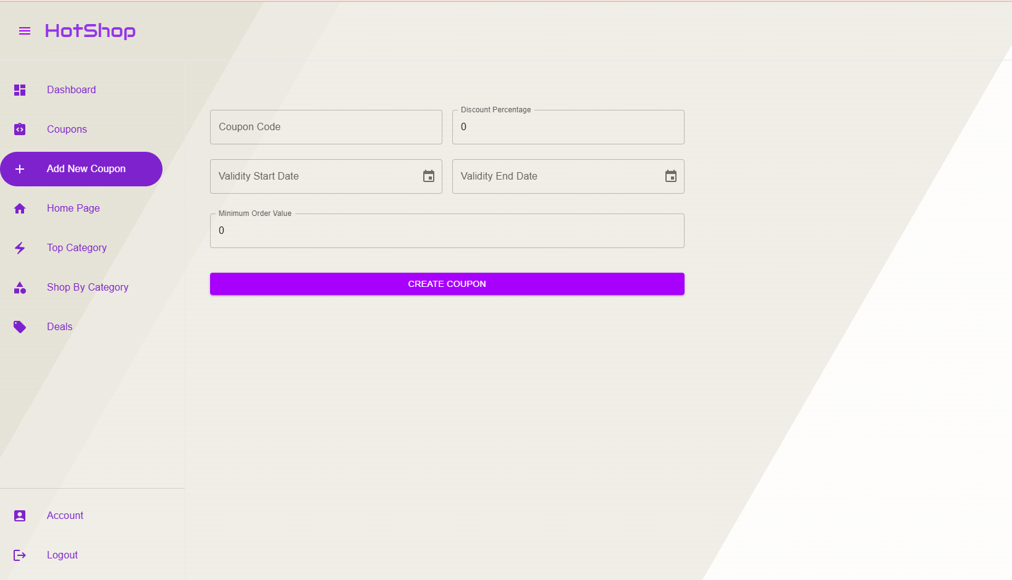
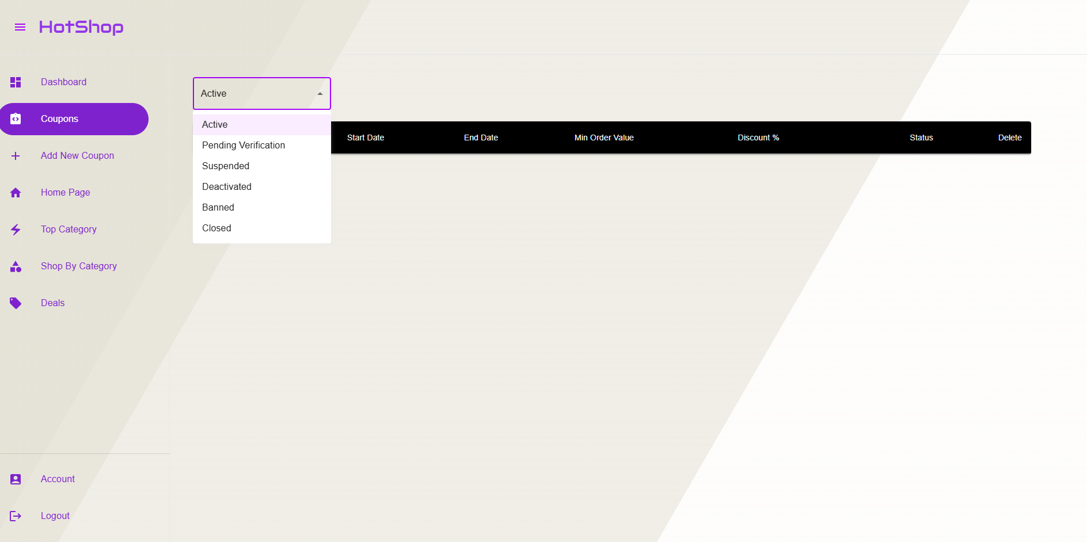
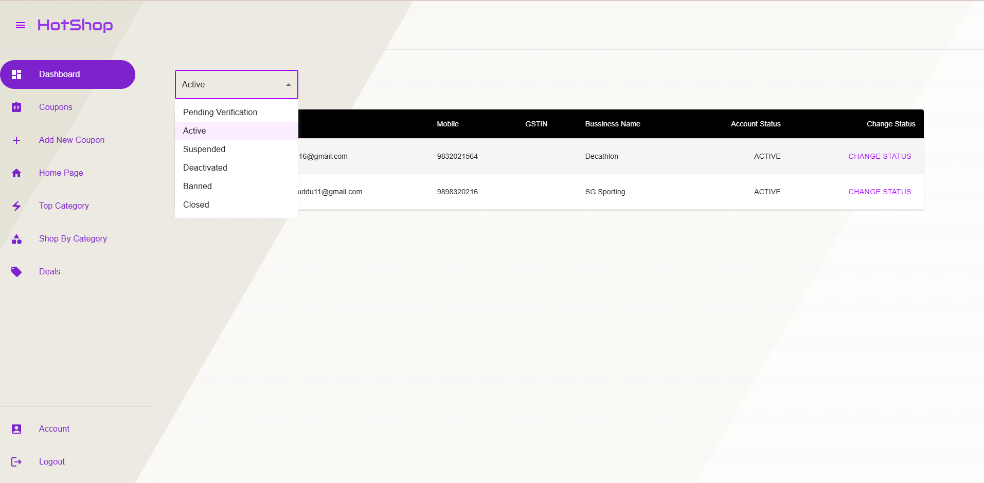
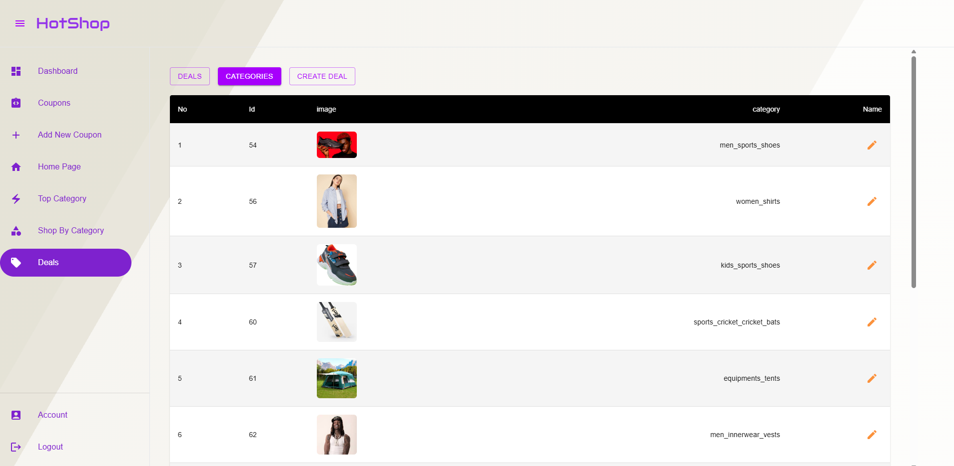
COUPON
ADD COUPON
DASHBOARD
DEALS

Slide 15
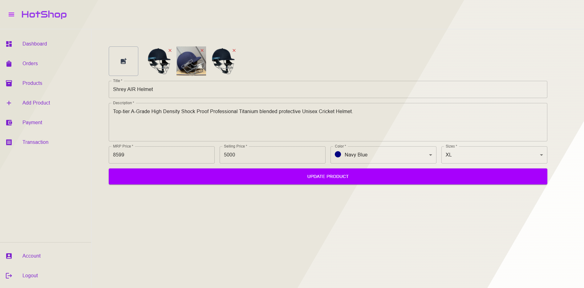
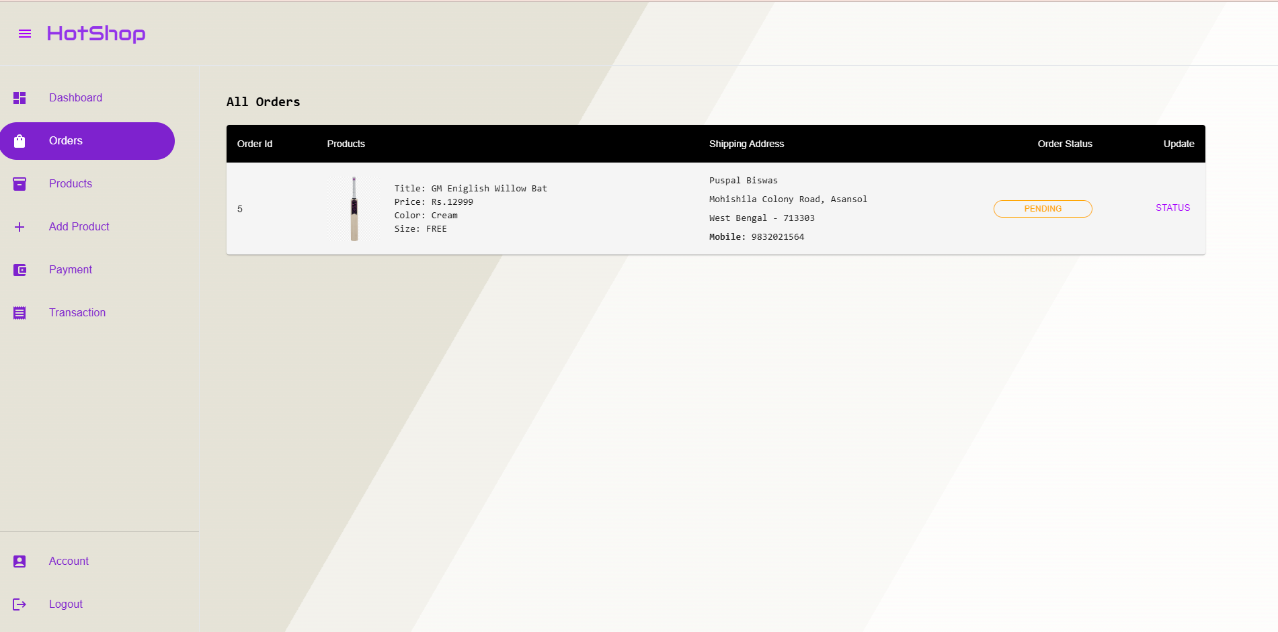
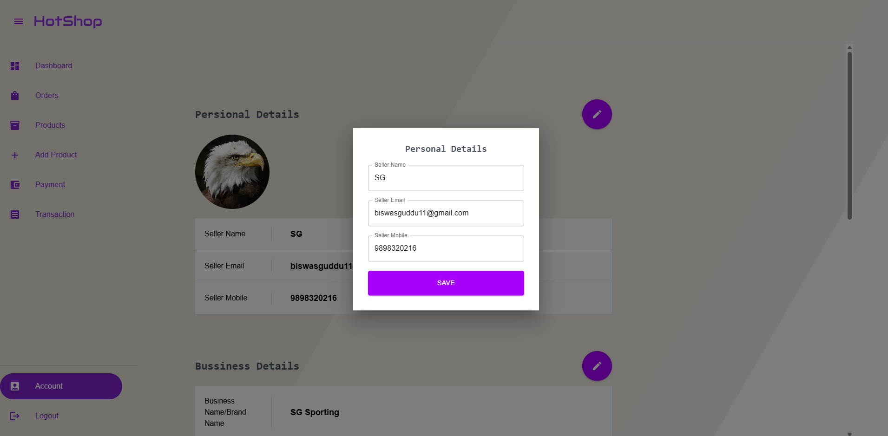
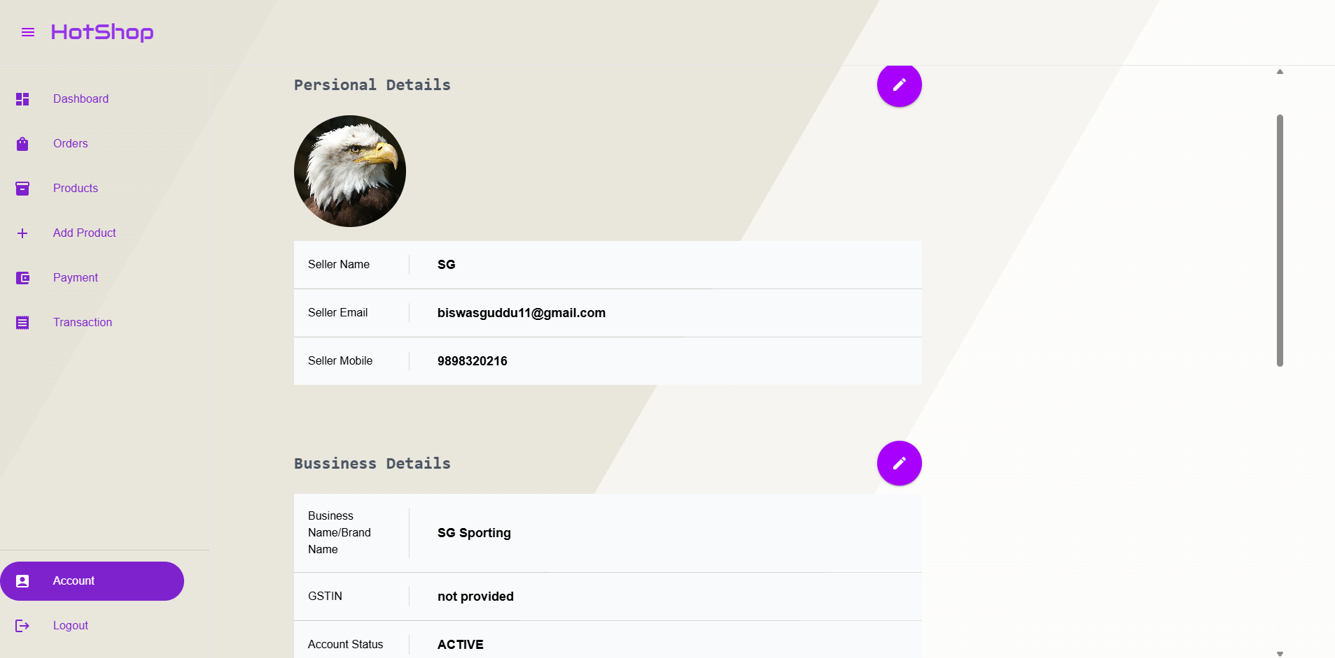
UPDATE PRODUCT
ORDERS
SELLER PROFILE UPDATE
SELLER PROFILE

Slide 16
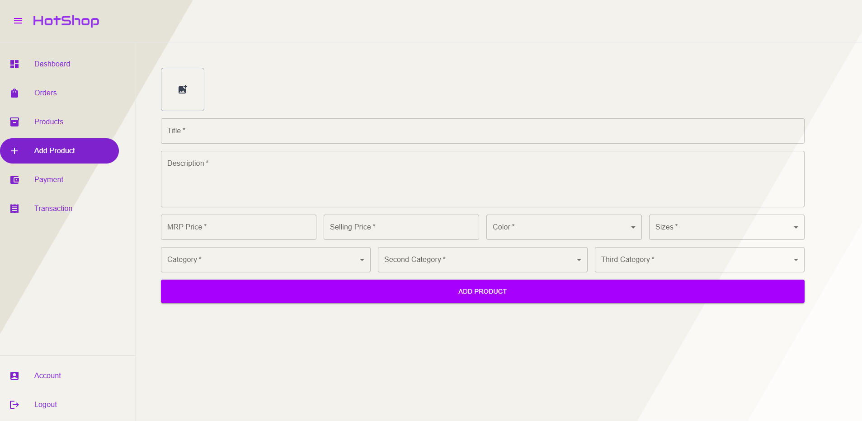
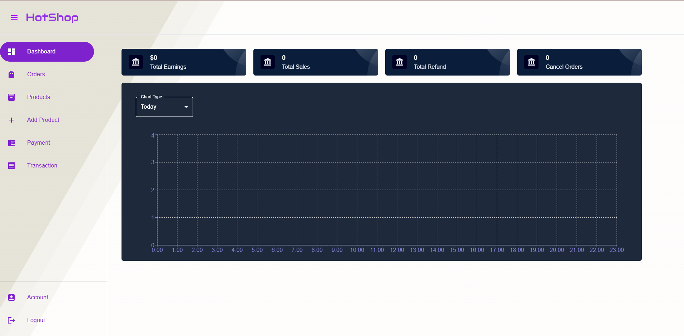
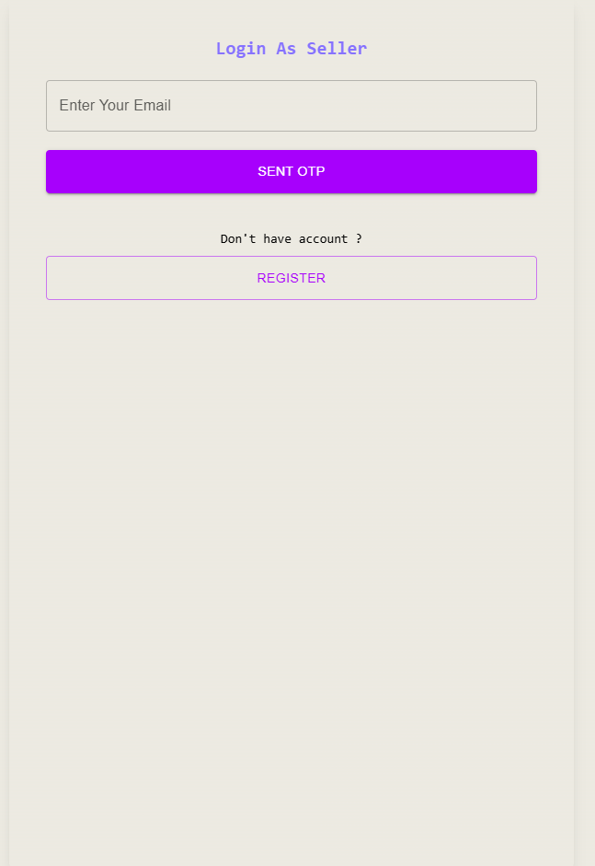
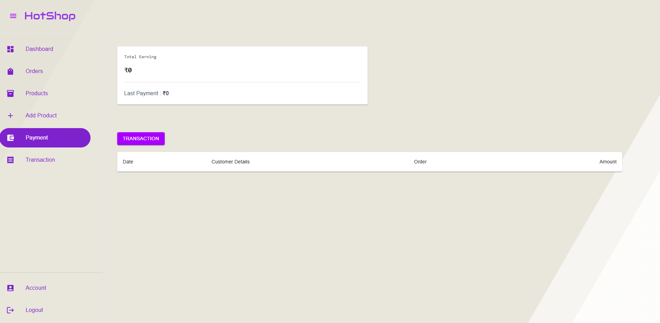
ADD PRODUCT
DASHBOARD
SELLER LOGIN
SELLER REVENUE

Slide 17
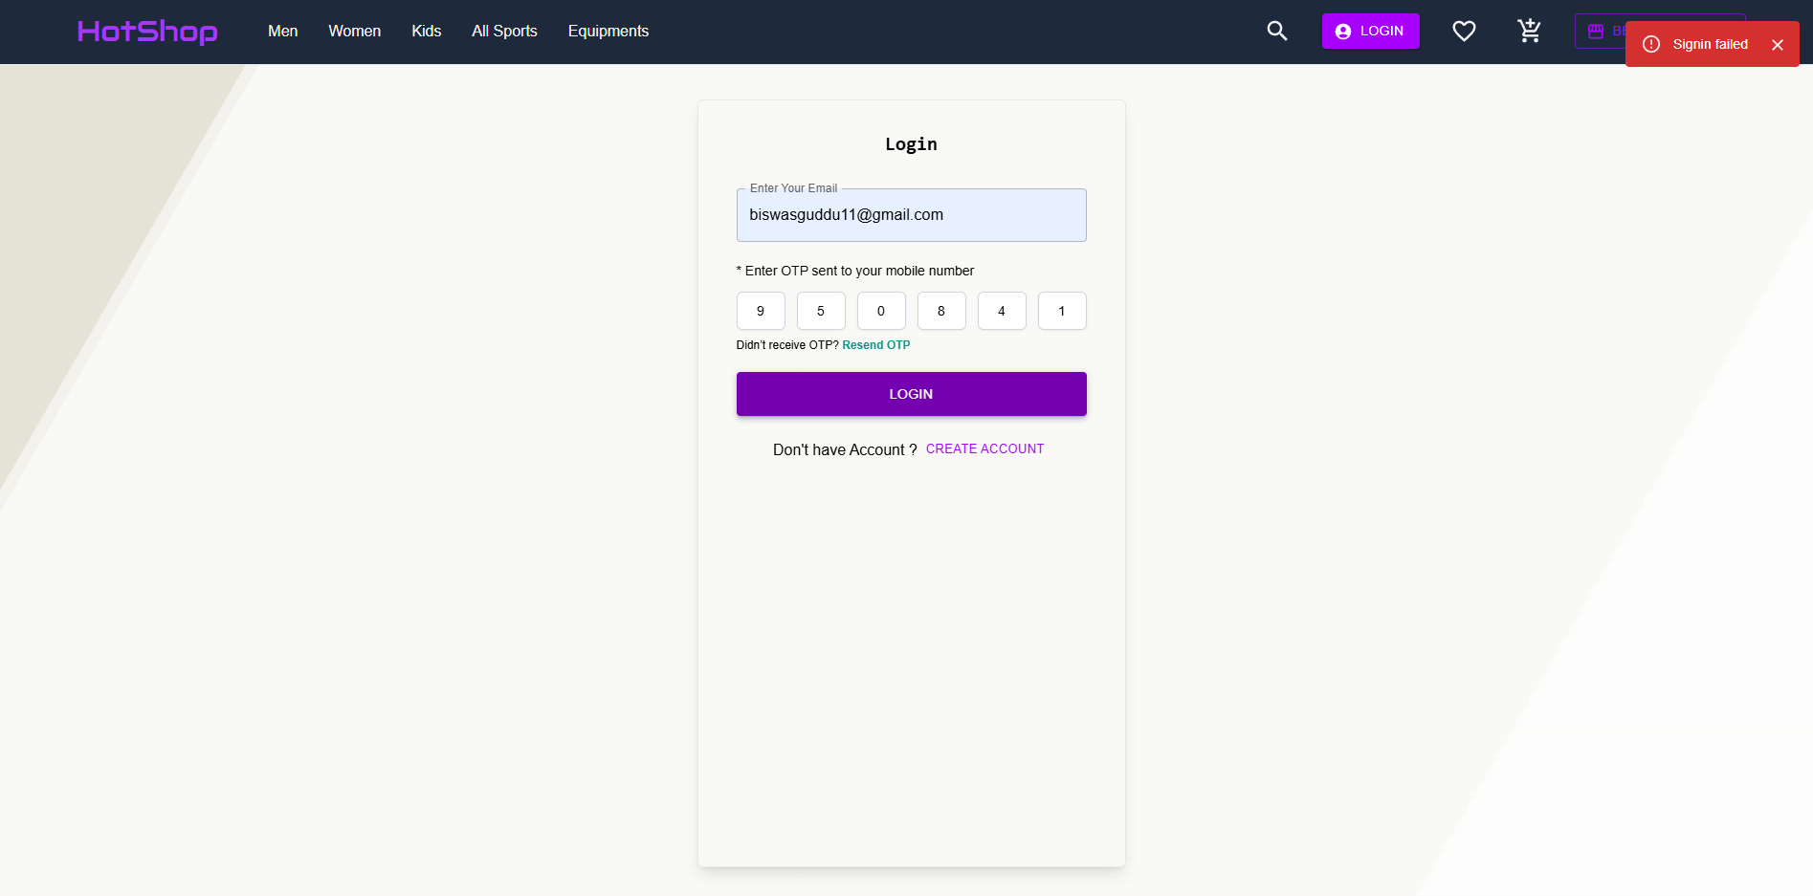
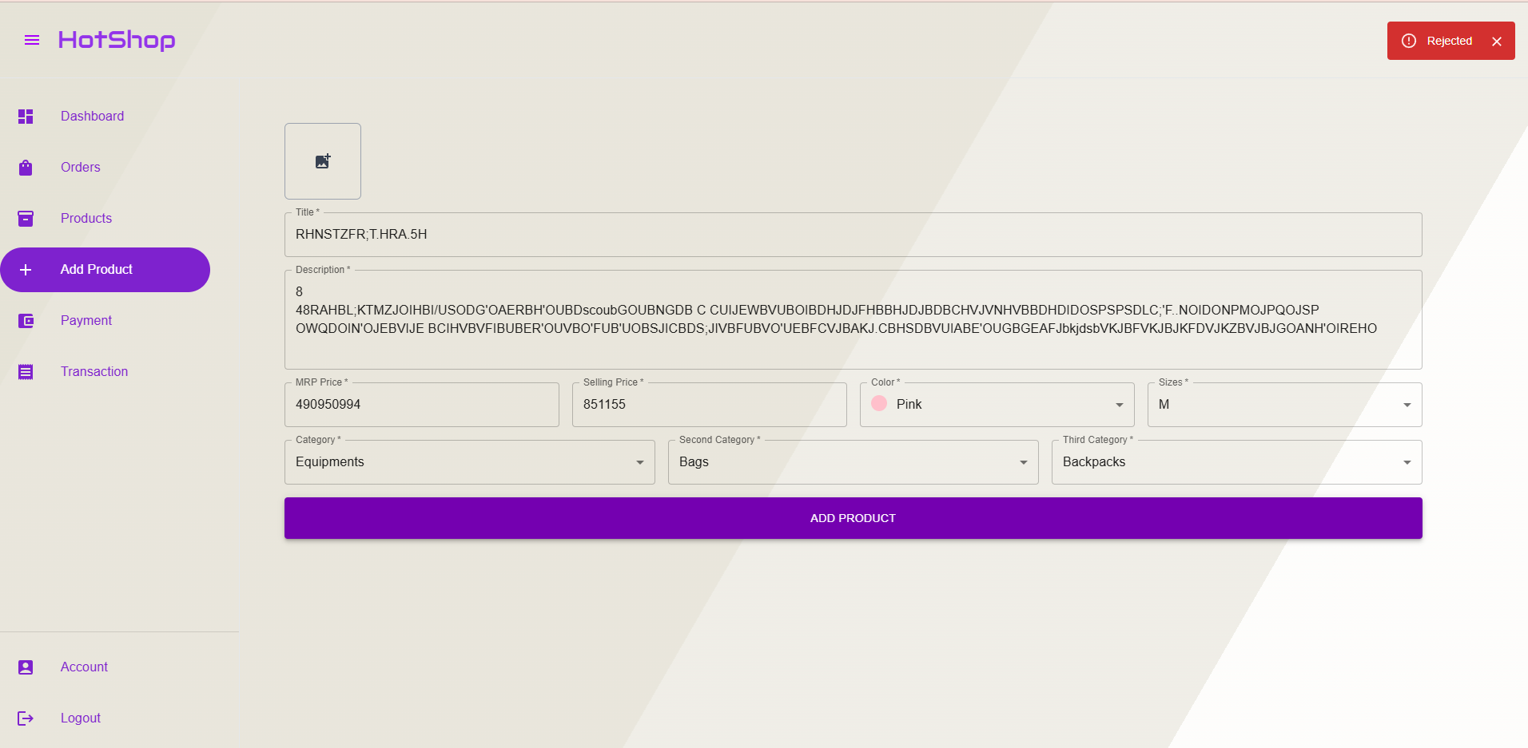
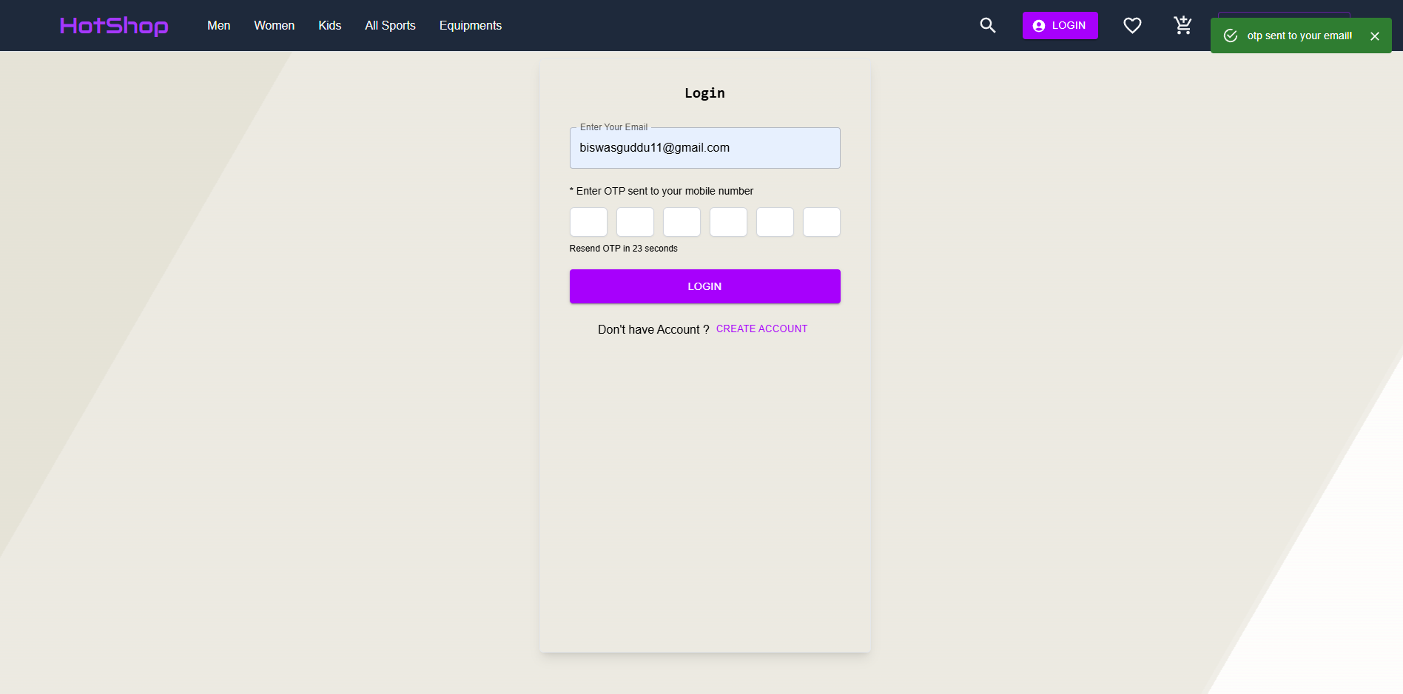
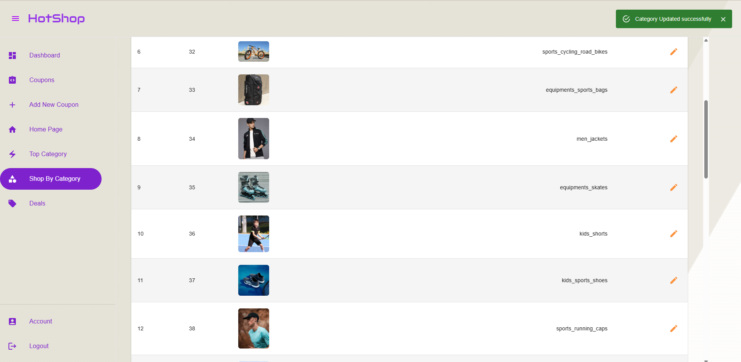
TESTING
Negative Testing
Positive Testing

Slide 18
TESTING
ALL TESTING CASES
MODULE | TEST CASE | EXPECTED RESULT | RESULT
SELLER | NEW LOGIN | USERNAME DOES NOT EXIST | PASSED
CUSTOMER | PROVIDES WRONG OTP | WRONG OTP | PASSED
CUSTOMER | INVALID USERNAME | WRONG USERNAME | PASSED
CUSTOMER | ADD/UPDATE PRODUCT | MODFYING OR ADDING FAILED | PASSED
MODULE | TEST CASE | EXPECTED RESULT | RESULT
ADMIN | COUPON CREATION | COUPON ALREADY EXISTS/INVALID COUPON | PASSED
ADMIN | UPDATE CATEGORY ERROR | FAILURE IN UPDATION | PASSED
ADMIN | INVALID USERNAME | WRONG USERNAME | PASSED
ADMIN | WRONG OTP | INVALID/WRONG OTP | PASSED
MODULE | TEST CASE | EXPECTED RESULT | RESULT
CUSTOMER | NEW LOGIN | USERNAME DOES NOT EXIST | PASSED
CUSTOMER | PROVIDES WRONG OTP | WRONG OTP | PASSED
CUSTOMER | INVALID USERNAME | WRONG USERNAME | PASSED
CUSTOMER | PAYMENT | TRANSACTION FAILED | PASSED

Slide 19
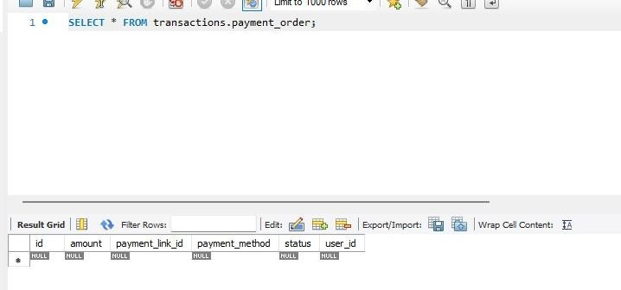
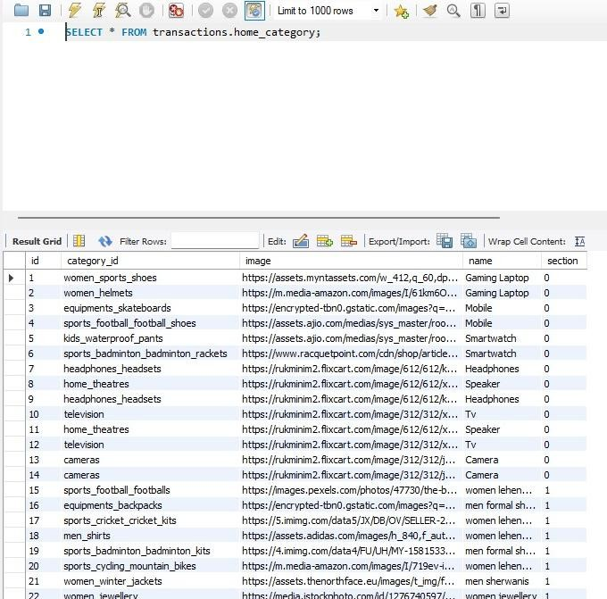
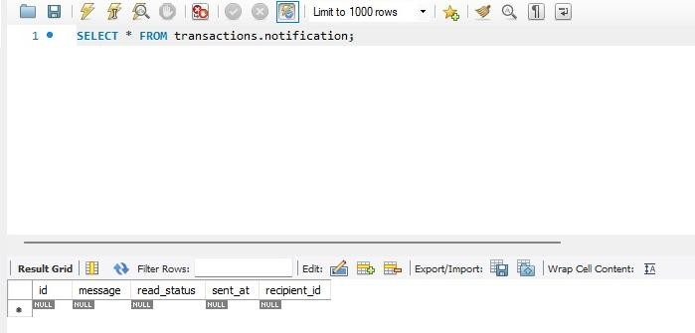
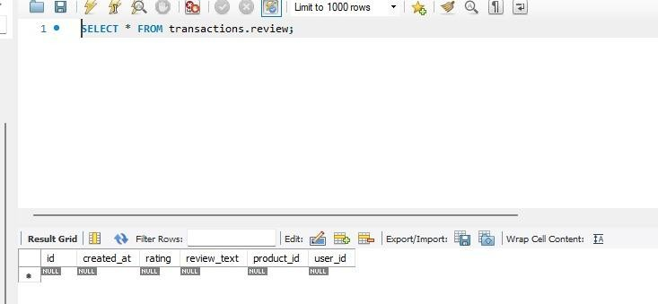
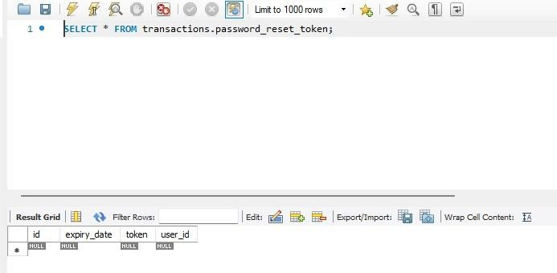
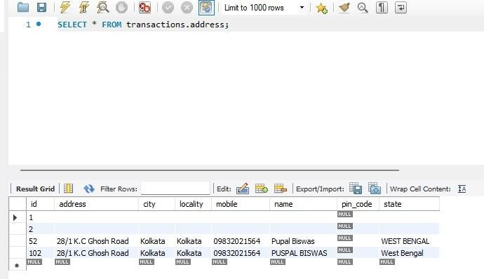
DATABASE TABLES
PAYMENT ORDER
HOME CATEGORY
NOTIFICATION
REVIEW
RESET PASSWORD
ADDRESS

Slide 20
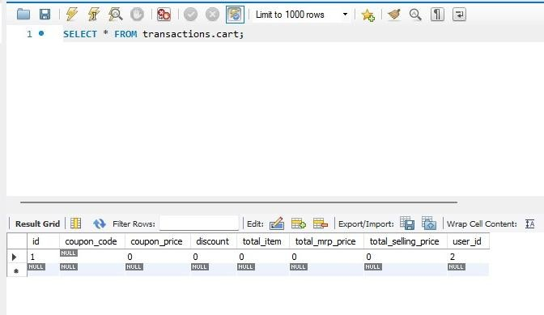
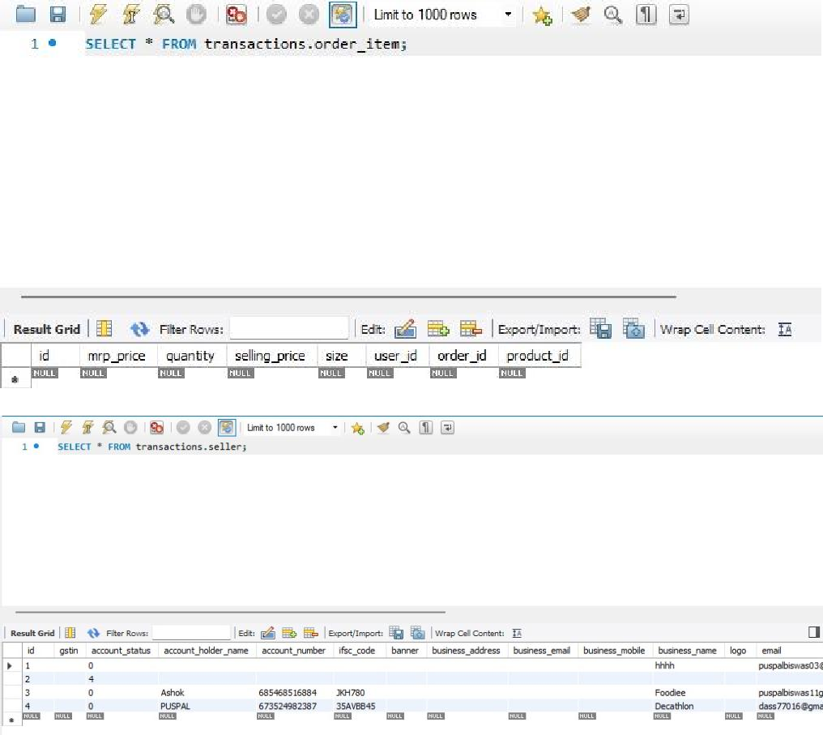
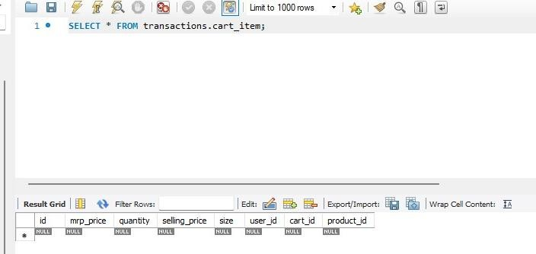
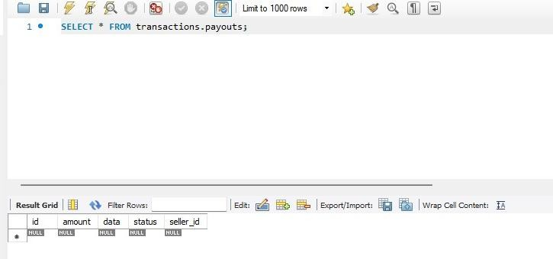
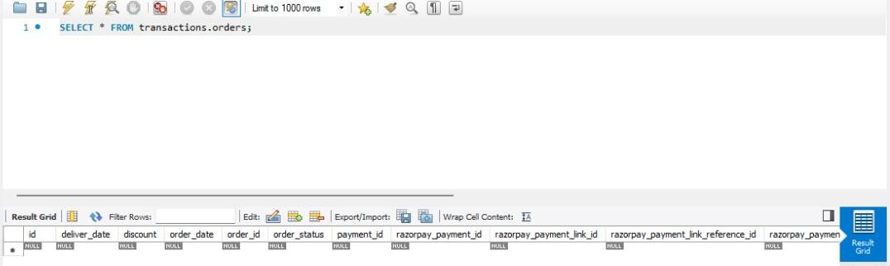
DATABASE TABLES
CART
ORDER ITEM
CART ITEM
SELLER
PAYOUTS
ORDERS

Slide 21
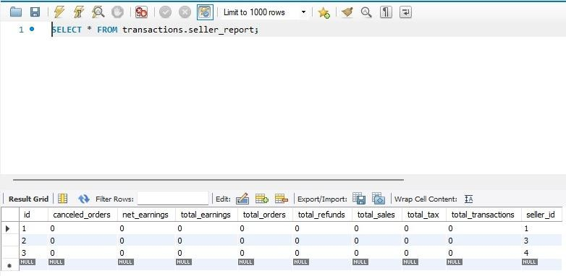
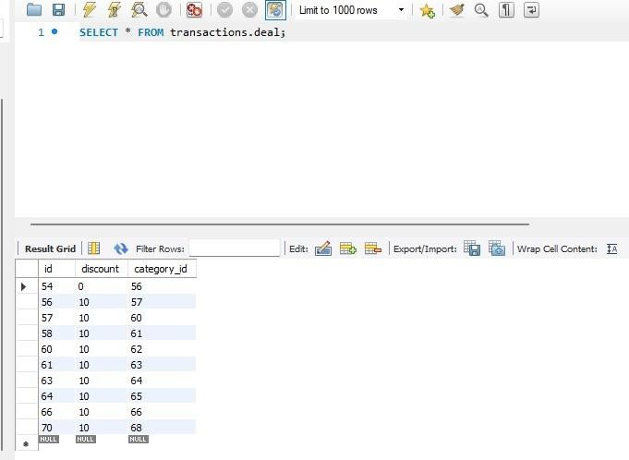
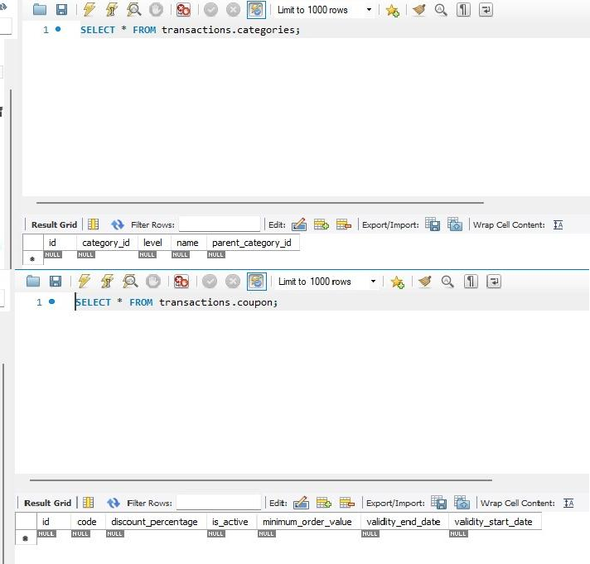


DATABASE TABLES
SELLER REPORTS
DEAL
CATEGORIES
USER
TRANSACTION
COUPON

Slide 22


DATABASE TABLES
PRODUCTS
VERIFICATION CODE

Slide 23
FUTURE SCOPE
The future scope of the Hotshop website includes expanding into emerging technologies and services to enhance the overall user experience and strengthen its market position. This involves integrating AI-driven product recommendations, virtual try-on features for apparel and footwear, and advanced fitness tracking integrations with wearables. Hotshop also aims to introduce a subscription-based model for exclusive fitness plans, early access to new product launches, and member-only discounts. Additionally, the platform envisions building a community hub where users can share reviews, participate in fitness challenges, and access expert advice. With plans to expand logistics for faster delivery and enter international markets, Hotshop is poised to become a comprehensive digital ecosystem for sports and wellness enthusiasts worldwide.

Slide 24
CONCLUSION
In conclusion, the Hotshop sports e-commerce website project successfully demonstrates how technology can be leveraged to create a seamless and engaging shopping experience for fitness and sports enthusiasts. By offering a wide range of high-quality products, intuitive navigation, secure transactions, and user-focused features, the platform not only meets current market demands but also encourages a healthier, more active lifestyle. This project reflects a strong foundation in both technical and design skills, and its scalable architecture ensures readiness for future enhancements and business growth. Overall, Hotshop stands as a reliable, innovative, and accessible solution in the evolving landscape of online sports retail.

Slide 25
BIBLIOGRAPHY
.www.google.com
.www.stackoverflow.com
.www.tutorialspoint.com

Slide 26
THANK YOU!
We extend our heartfelt gratitude to our esteemed teachers and mentors whose constant support, encouragement, and guidance made the successful completion of this project possible. Your insightful feedback, patience, and dedication have been instrumental in helping us understand both the technical and practical aspects of building a real-world e-commerce platform like Hotshop. This project would not have reached its potential without your valuable mentorship. Thank you for inspiring us to push our limits and strive for excellence.

